Slide 1
Hong Kong Great November Feast (1- 30 November 2016)

Slide 2
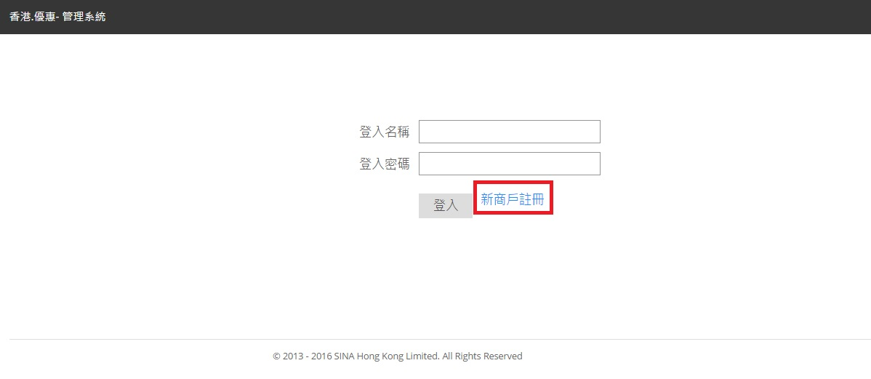
Birthday wine programme
Hotel / Attraction F&B outlets to offer a free bottle of wine to visitors whose birthday is in November.
A minimum spending of HK$500 per table is required.
Applicable to bona fide visitors aged 18 or above.
Exposures: HKTB event guide and website.
How
Step 1: Hotel / attraction’s dining outlets to create e-Coupon on Hong Kong Value Offer CMS **
by 9 September 2016 (Friday).
Step 2: Visitors to present e-Coupon to redeem the birthday wine at participating hotels/attractions.
** Please click “ 新商戶註冊” if your hotel/attraction does not have account yet.

Slide 3
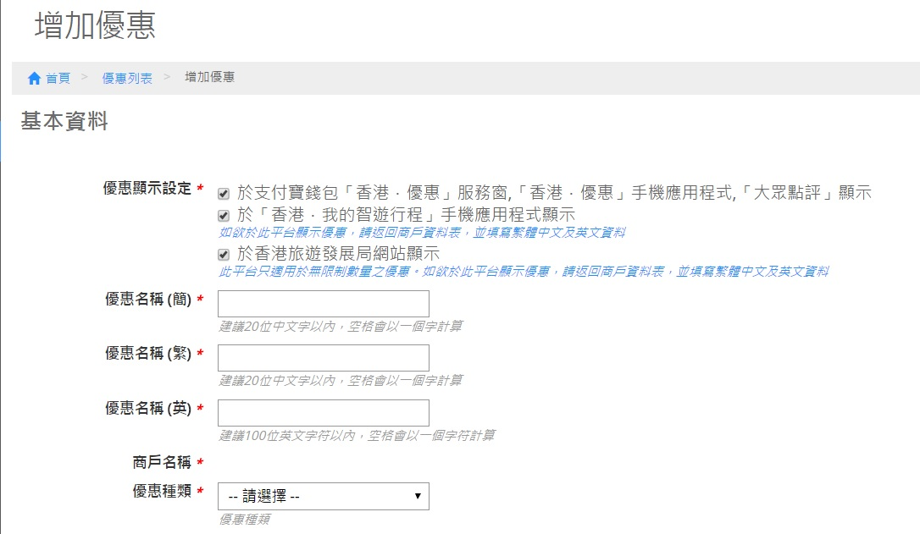
Birthday wine programme (suggested wordings on CMS)
(
11月寿星惠顾 (餐厅名称)，可获美酒一瓶
11月壽星惠顧 (餐廳名稱)，可獲美酒一瓶
Free bottle of wine for visitors whose birthday falls in November at (Restaurant Name)
普通

Slide 4
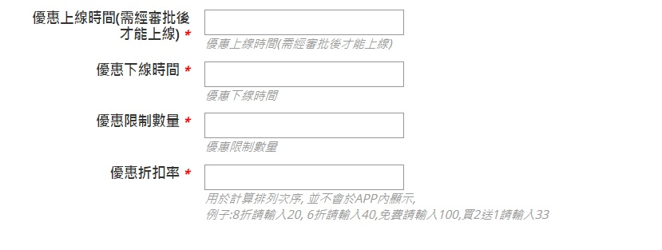
Birthday wine programme (suggested wordings on CMS)
9月20日00:00:00 或之前
11月30日 23:59:59
0
100

Slide 5
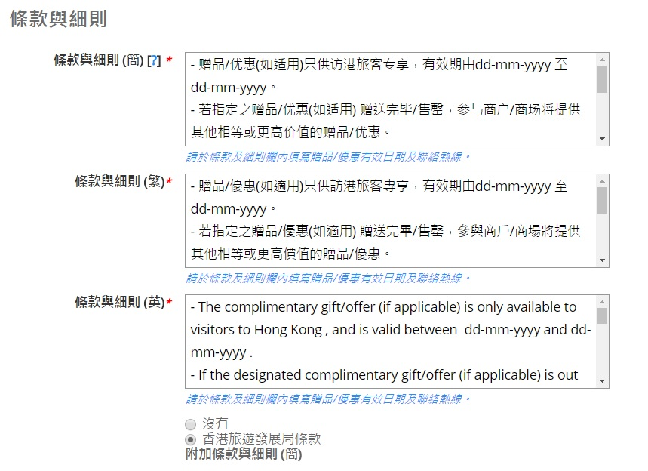
Birthday wine programme (suggested wordings on CMS)
- 单次消费满港币$500或以上，方可享有此优惠。
- 请出示旅游证件，以确认出生日期。
- 此优惠适用于18周岁或以上的访港旅客。
- 2016年11月1至30日期间， 每位访港旅客最多只可享用一次此优惠。
-于餐厅用餐，方可享用此优惠。
- 單次消費滿港幣$500或以上，方可享有此優惠。
- 請出示旅遊證件，以確認出生日期。
- 此優惠適用於18周歲或以上的訪港旅客。
- 2016年11月1至30日期間， 每位訪港旅客最多只可享用一次此優惠。
-於餐廳用餐，方可享用此優惠。
Please select HKTB T&C , update the promotion period & hotline no., & add the right hand side T&C and any other T&C that apply to this offer on CMS.

Slide 6
Birthday wine programme (suggested wordings on CMS)
- A minimum spending of HK$500 per table is required.
- Travel document required for verification of date of birth.
- Applicable to bona fide visitors aged 18 or above only.
- Each visitor may only redeem this offer once from 1–30 November 2016.
- Applicable to dine-in only.
Please select HKTB T&C , update the promotion period & hotline no., & add the right hand side T&C and any other T&C that apply to this offer on CMS.

Slide 7
Enquiries
Ms Kristy Leong Tel: 2807 6227 E-mail: kristy.leong@hktb.com Ms Vivian Cheung Tel: 2807 6264 E-mail: vivian.cheung@hktb.com

Slide 8
Thank You
8
Notes:
8

